Slide 1

AI-Powered Insurance Claim Fraud Detection and Risk Analytics Platform
Presented by:
K . Rakesh (192525075)
M.Mohan siva(192573011)
Nandheesa prasad(192511181)
Pon surya (192411145)
Tharun sai (192521486)
Guided by:
Dr.DS.Praveen

Slide 2

ABSTRACT
Develops an AI-powered platform to detect fraudulent insurance claims and assess claim risks.
Integrates customer, policy, claim, and payment data into a centralized data warehouse using the ETL process.
Applies data mining and AI techniques to identify fraud patterns and predict high-risk claims.
Provides real-time dashboards, fraud alerts, and risk analytics to support faster and more accurate decisions.
Reduces financial losses, improves claim processing efficiency, and enhances customer satisfaction.

Slide 3

INTRODUCTION
Insurance fraud is one of the major challenges faced by insurance companies, leading to significant financial losses and delayed claim processing. Traditional fraud detection methods rely heavily on manual verification, making them slow and less effective. This project uses Artificial Intelligence (AI), Data Warehousing, and Data Mining techniques to identify fraudulent claims, analyze risk patterns, and assist insurance companies in making faster and more accurate decisions.

Slide 4
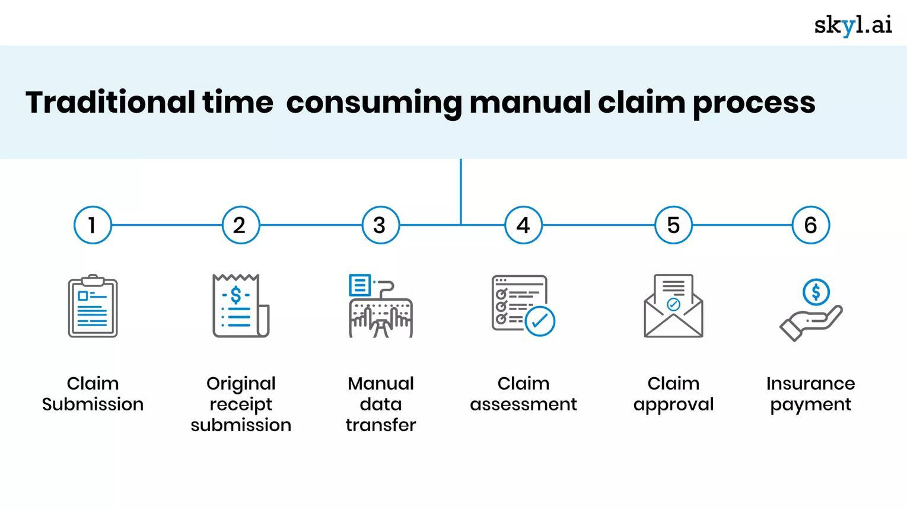
PROBLEM STATEMENT
Increasing number of fraudulent insurance claims.
Manual verification is slow and time-consuming.
Large amounts of insurance data are difficult to analyze.
High operational costs due to fraud investigations.
Delayed claim approval affects customer satisfaction.

Slide 5

OBJECTIVES
Develop a centralized insurance data warehouse.
Detect fraudulent insurance claims using AI.
Analyze claim patterns using data mining.
Predict risk scores for insurance claims.
Generate reports for better decision-making.

Slide 6
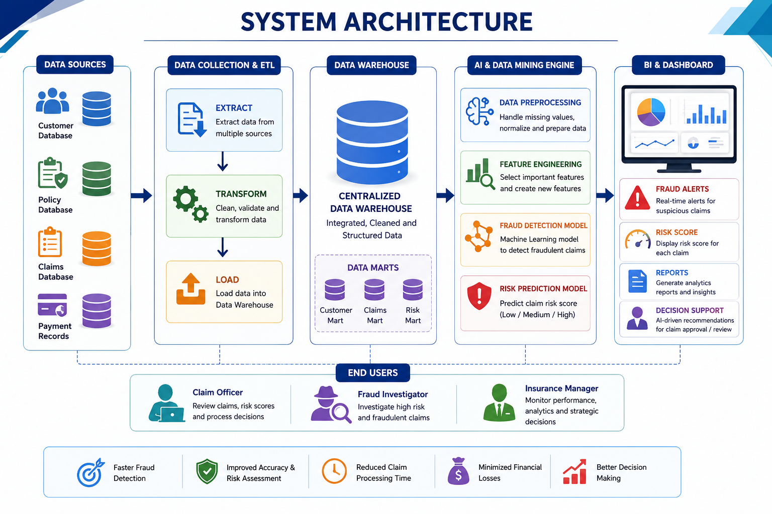

Slide 7
MODULES
Module 1 : Data Collection & Integration
Module 2 : ETL & Data Warehouse Management
Module 3 : AI-Based Fraud Detection
Module 4: Risk Analytics & Prediction
Module 5: Dashboard & Decision Support Purpose

Slide 8
Module 1
Data Collection & Integration
Collects insurance data from customers, policies, claims, payments, and hospital/repair records.
Integrates data from multiple sources into a single unified dataset.
Validates data to identify missing, duplicate, or inconsistent records.
Cleans and standardizes data to ensure accuracy and consistency.
Prepares high-quality data for the ETL (Extract, Transform, Load) process.
Produces a validated and integrated dataset ready for storage in the centralized data warehouse and further AI-based fraud analysis.

Slide 9
Module 2
ETL & Data Warehouse Management
Extracts insurance data from multiple sources, including customer, policy, claim, and payment databases.
Transforms the extracted data by cleaning, formatting, and standardizing it for consistency.
Loads the processed data into a centralized Data Warehouse for secure storage.
Organizes historical and current insurance data for efficient retrieval and analysis.
Supports OLAP and data mining techniques for fraud detection and risk analytics.
Provides a reliable, integrated data repository for AI models, dashboards, and business intelligence reports.

Slide 10
Module 3
AI-Based Fraud Detection
Uses Artificial Intelligence (AI) to analyze insurance claim data and identify fraudulent activities.
Applies machine learning algorithms to detect suspicious claim patterns and anomalies.
Compares new claims with historical records to identify duplicate or abnormal claims.
Assigns a fraud probability score to each claim based on risk factors.
Classifies claims as Genuine or Fraudulent for faster decision-making.
Improves fraud detection accuracy, reduces false claims, and minimizes financial losses for insurance companies.

Slide 11
Module 4
Risk Analytics & Prediction
Analyzes historical insurance claims to identify high-risk patterns and trends.
Calculates a risk score for each claim based on customer, policy, and claim details.
Uses predictive analytics to estimate the likelihood of fraudulent or risky claims.
Categorizes claims into Low, Medium, and High Risk for efficient processing.
Helps investigators prioritize high-risk claims for detailed verification.
Supports faster, data-driven decision-making while reducing financial losses and improving claim management.

Slide 12
Module 5
Dashboard & Decision Support Purpose
Provides an interactive dashboard to monitor insurance claims in real time.
Displays fraud detection results and risk scores for each claim.
Generates reports, charts, and business analytics for better insights.
Helps claim officers track claim status and investigation progress.
Supports data-driven decision-making for claim approval or rejection.
Improves operational efficiency by enabling faster and more accurate decisions.

Slide 13
CONCLUSION
Developed an AI-powered platform to detect fraudulent insurance claims and assess claim risks.
Centralized insurance data using ETL and Data Warehousing for efficient data management.
Applied AI and Data Mining techniques to improve fraud detection accuracy and risk prediction.
Provided interactive dashboards and analytics for faster, data-driven decision-making.
Reduced financial losses, improved claim processing efficiency, and enhanced customer satisfaction through intelligent insurance analytics.

Slide 14

Future Scope
Integrate real-time data from hospitals, repair centers, and IoT devices for faster fraud detection.
Deploy the platform on the cloud to improve scalability, security, and accessibility.
Implement deep learning and explainable AI (XAI) to enhance fraud detection accuracy and transparency.
Develop a mobile application for claim tracking, fraud alerts, and risk monitoring.
Incorporate blockchain technology to ensure secure, transparent, and tamper-proof insurance claim records.

Slide 15
REFERENCES
Gomes, C., Jin, Z., & Yang, H. (2021). Insurance fraud detection with unsupervised deep learning. Journal of Risk and Insurance, 88(3), 591–624. https://doi.org/10.1111/jori.12359 Wiley Online Library
Kumar, P. A., & Sountharrajan, S. (2025). Insurance claims estimation and fraud detection with optimized deep learning techniques. Scientific Reports, 15, 27296. https://doi.org/10.1038/s41598-025-12848-0 Nature
Dana Ebinezer, M. J., & Krishna, B. C. (2025). Life Insurance Fraud Detection: A Data-Driven Approach Utilizing Ensemble Learning, CVAE, and Bi-LSTM. Applied Sciences, 15(16), 8869. https://doi.org/10.3390/app15168869 MDPI
Pant, P. (2025). Data Warehousing, AI, and P&C Insurance: A Transformative Approach. International Research Journal of Modernization in Engineering Technology and Science (IRJMETS). ResearchGate

Slide 16


